Slide 1
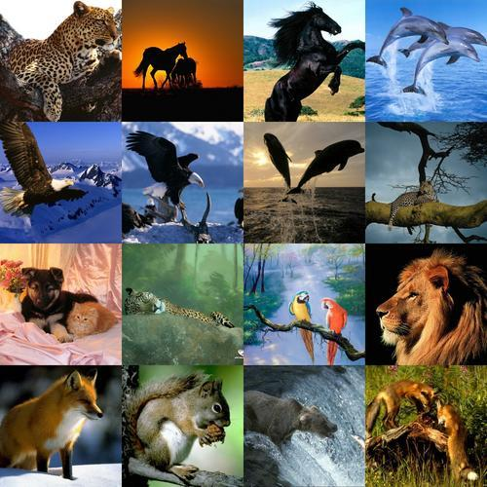

This bewildering variety of life around us has evolved on the earth over millions of years.
Confusing
Do we have time to try and understand all these living organisms?
We can not look at them one by one.

Slide 2
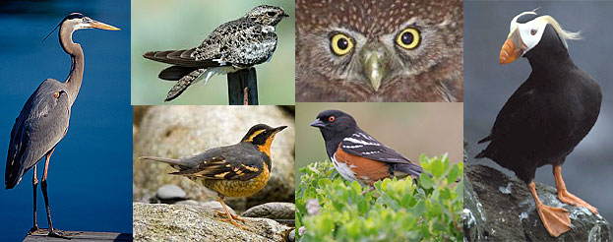
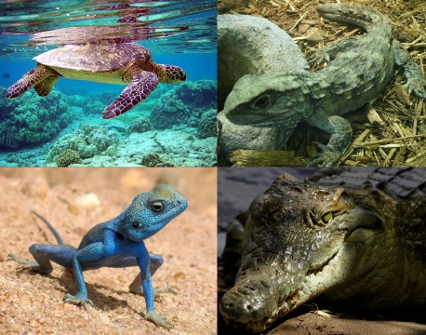
So, we look for similarities among the organisms, which will allow us to put them into different classes and then study different classes or groups as a whole.
Birds
Reptiles
In order to make relevant groups to study
the variety of life forms, we need to decide
which characteristics decide more
fundamental differences among organisms.
meaningful
basic

Slide 3
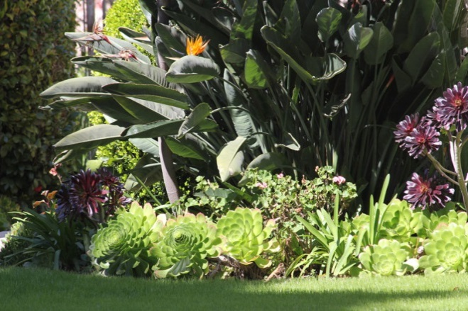
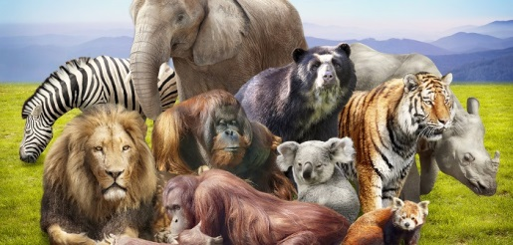
This would create the main broad groups of organisms.
Within these groups, smaller subgroups will be decided by less important characteristics.
So, there is a need to classify
all organisms on the basis of
similar characteristics.

